Slide 1

A Data Science Approach for Analysis of Photovoltaic Solar Cell
Proposal Report
Kailei Liu, Zonglun Lee, Sijin Luozhong, Chih-Wei Hsu
February 21, 2019

Slide 2
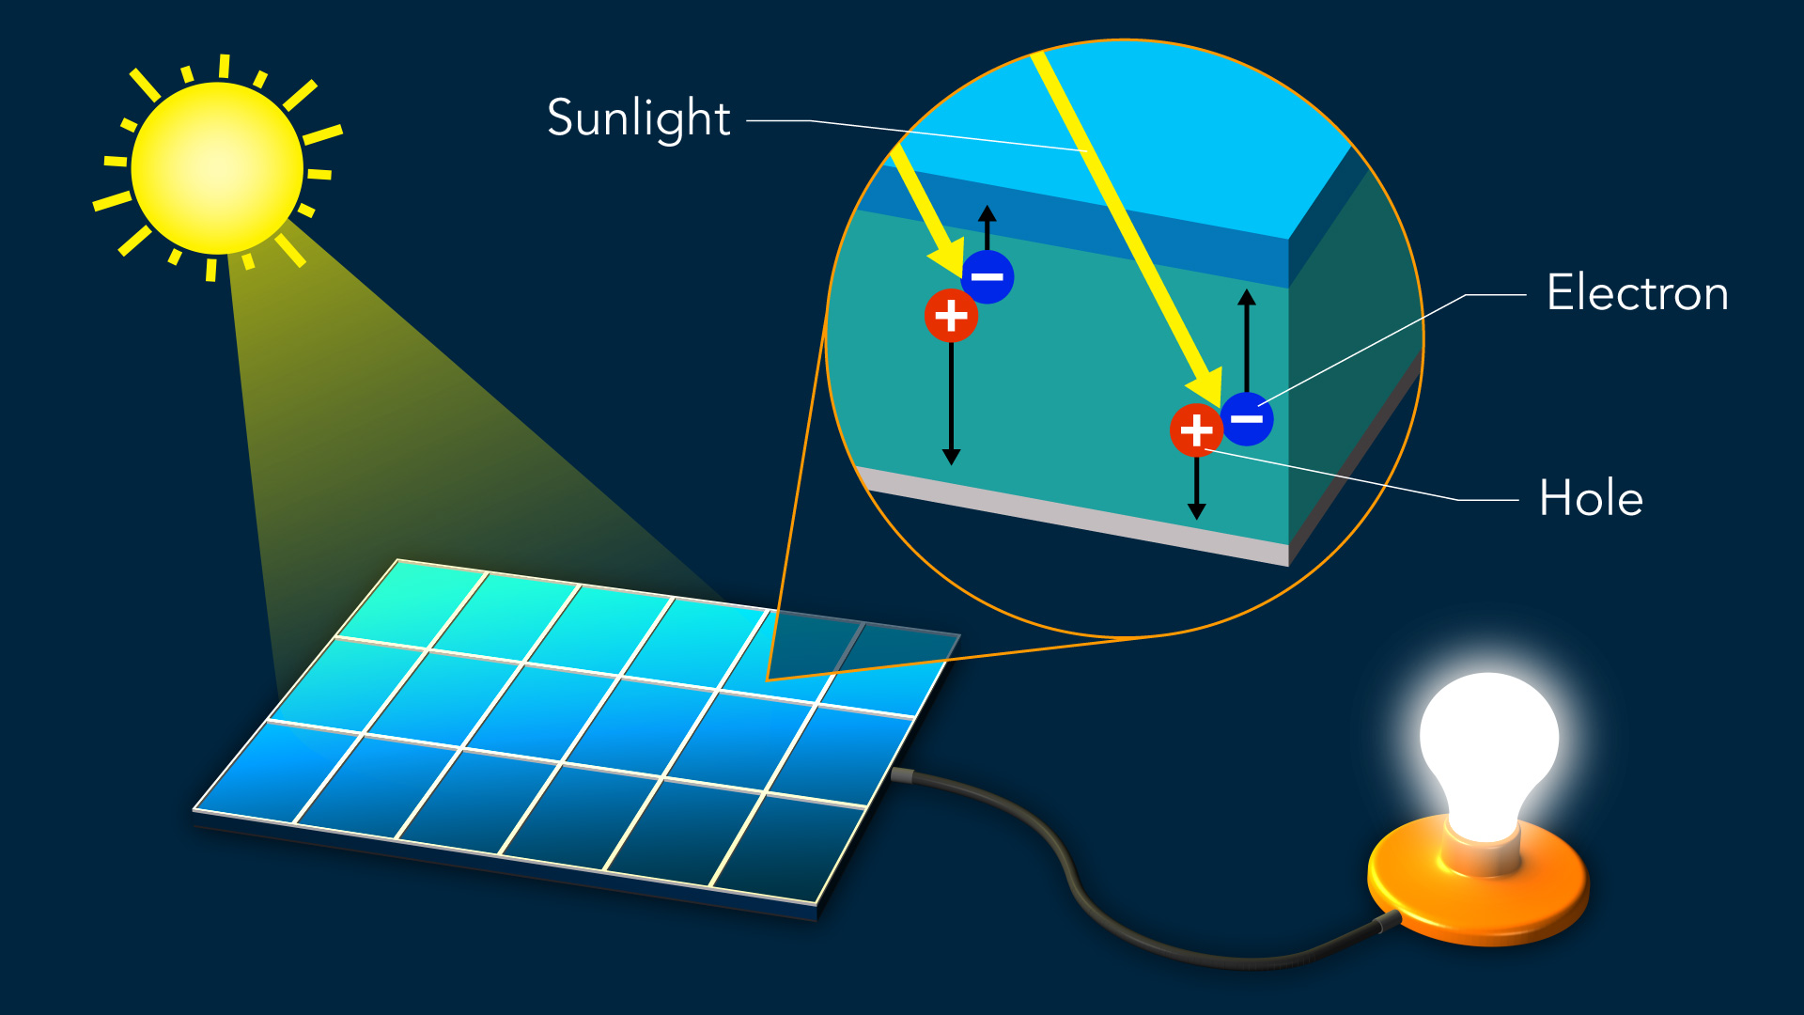
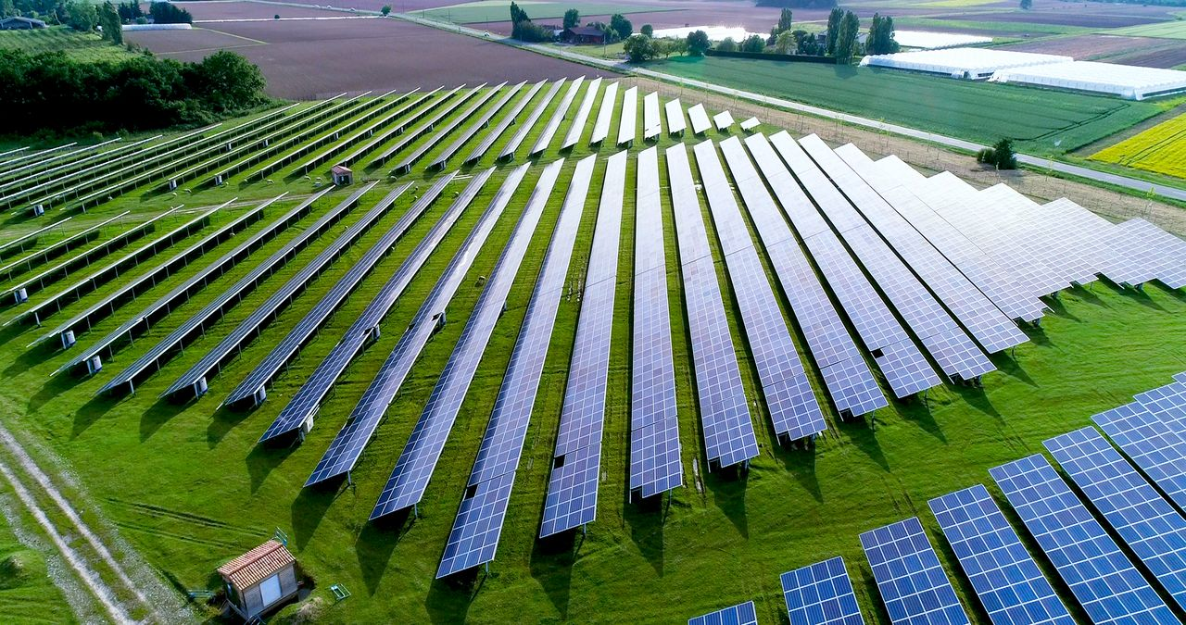
Photovoltaic(PV) Cell
Photovoltaic (PV) Cell converts solar energy to electrical energy.
Clean
Sustainable
Most available product is Silicon-based PV Cell (Conversion~25%*).
Bulky
Expensive
* S-Q limit: 33.7% for Single PN-junction PV cell
Notes:
Photovoltaic energy is known as a clean alternative to traditional energy like petroleum. It is one of the most popular renewable energy that converts solar energy into electricity.
Right now the solar photovoltaic industry is dominated by inorganic crystalline silicon photovoltaics (25%)

Slide 3
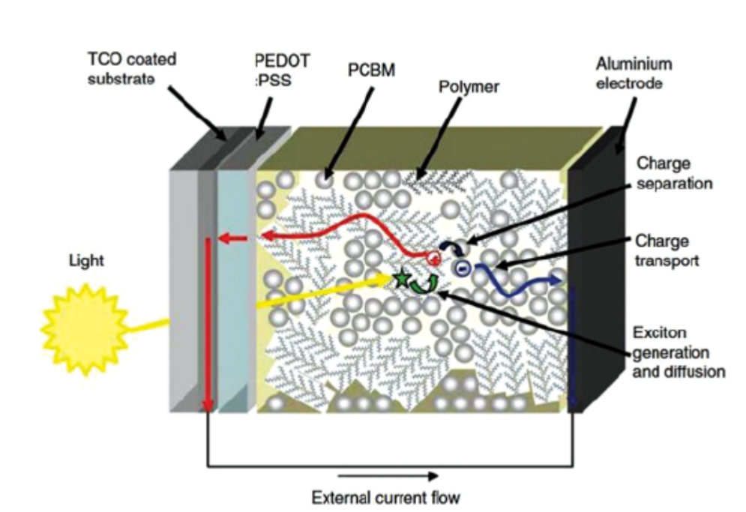
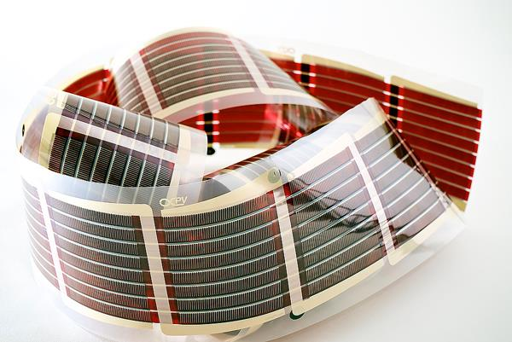
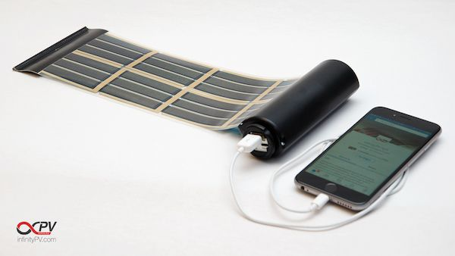
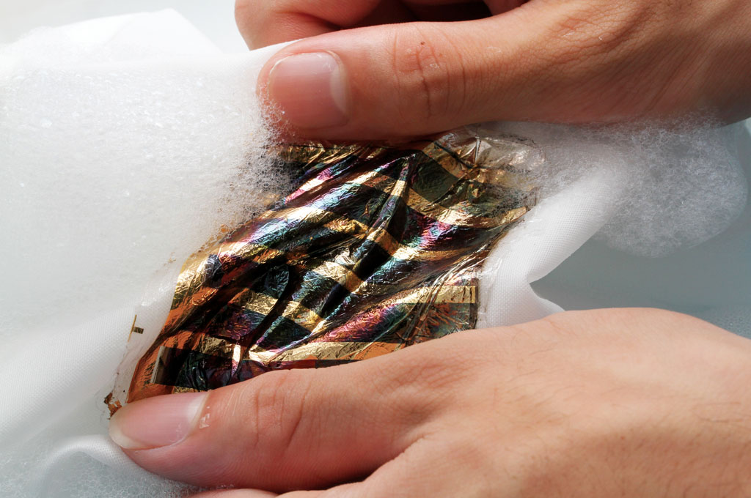
Organic PV Cell (OPVC)
Advantages:
Simple, Cheap and high-volume production;
Unique properties given by polymers
Shortcomings
Low efficiency (~11%)
low lifetime
OPVC
Internal Structure
Flexible
Portable
Washable

Slide 4
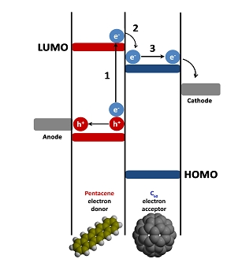
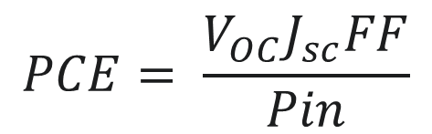
How Our Project Solves the Issue?
$$PCE= \frac{V_{OC}J_{sc}FF}{Pin}$$
PCE: Power Conversion Efficiency
V_{oc}: Open Circuit Voltage—related to molecule’s LUMO & HOMO energy gap
FF: Fill Factor
P_{in}: Input Power (Incident Ligtht)

Slide 5
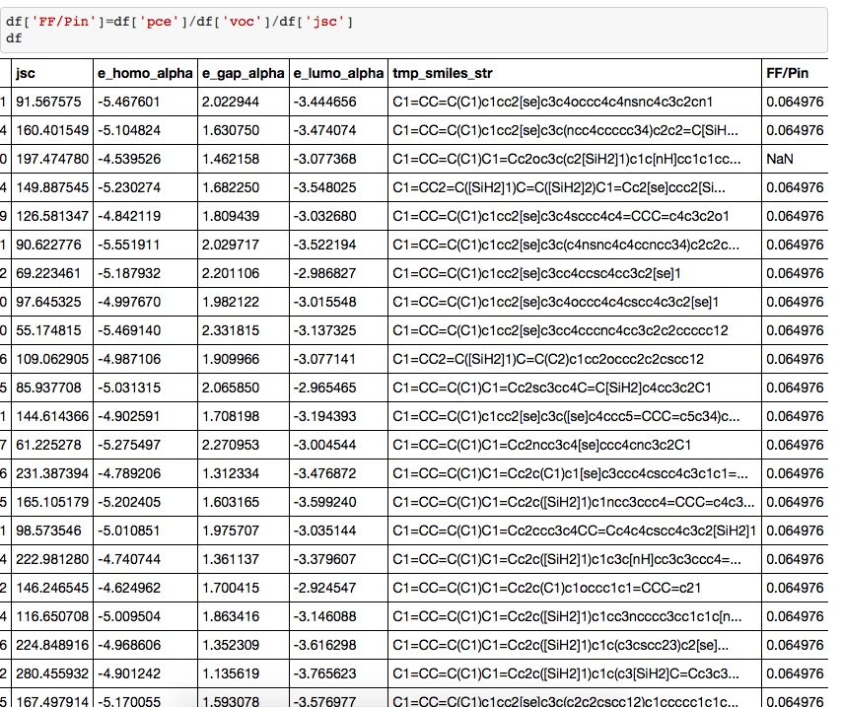
How Our Project Solves the Issue?
Database: Harvard Clean Energy Project Database (HCEPDB)

Slide 6
How Our Project Solves the Issue?
Model
Molecular Structure:
Chemical Bonding
# and types of the Functional Groups
Presence of heteroatom(S, Si)
Bonding Position
Contribution/Weigh
Power Conversion Efficiency(PCE)
Target
Predict Optimal Polymer Structure
Notes:
The technology of polymer-based organic photovoltaic (OPV) cells has made great progress in the past decade, with the power conversion efficiency increasing from just a few per cent to around 12%, and the stability increasing from hours to years.

Slide 7
Flow Chart
20%
Testing_Set
HCEPDB_moldata.csv
Data Input
(40K molecules)
Cleaning & Categorizing
Predict
Chemical SMILE-string
OpenEye
RDKit
Pybel
80%
Training_Set
+
Associated
PCE
Function
Training_Data
Model
OpenEye
RDKit
Pybel
TensorFlow
Scikit-learn
Keras

Slide 8

Chemical Informatic Packages
Extract chemical fingerprint information
SMILES string Functional groups, bondings, etc.
Molecular similarity analysis
Read CDX/SDF … files
.sdf file
SMILES strings
C1=CC=CC=C1

Slide 9
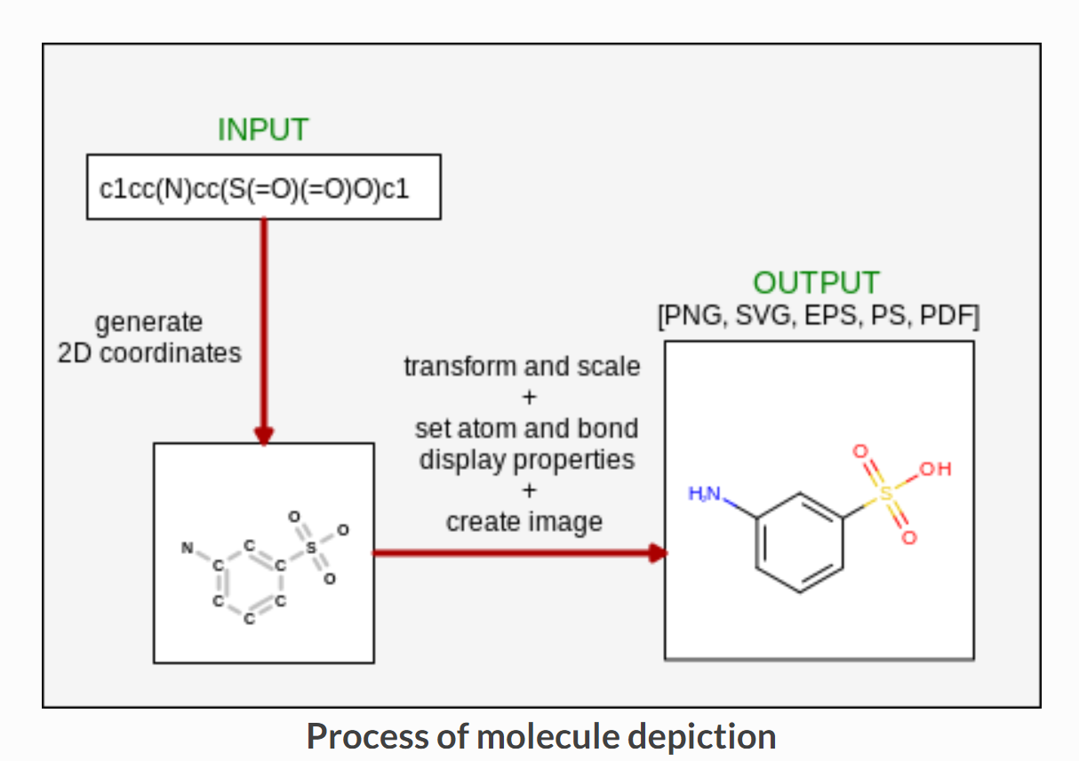
Chemical Informatic Packages

Slide 10
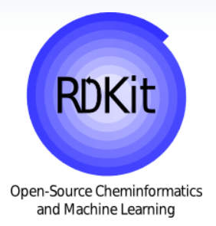



Package - Comparison
Pybel
Most powerful
Open source
Open source
Charged ($10000!!!)
Easy to follow
Decent tutorials

Slide 11
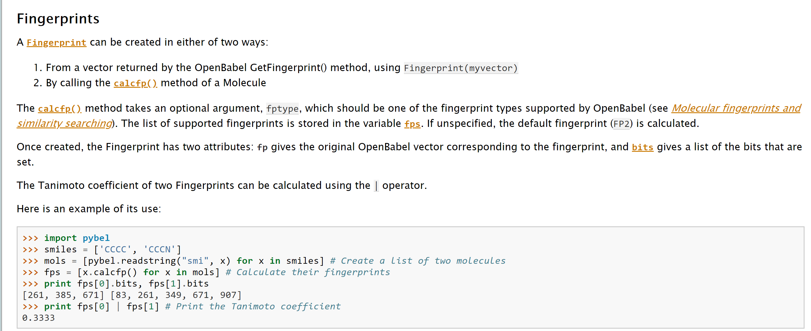
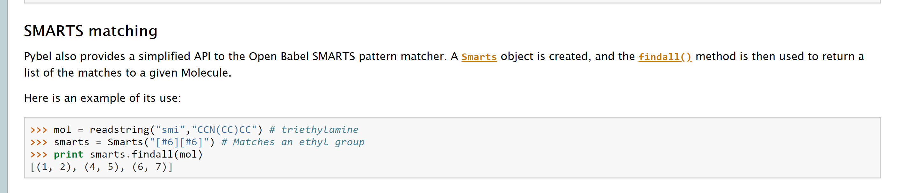
Pybel --- Open Source Package
Identifying and categorizing molecular structure features.

Slide 12



Package - Comparison
 | TensorFlow | scikit-learn | Keras
Pros | Deep flexibility High performance Can build your original algorithm | The easiest one to learn and use Provide multiple modules and models | Interface of TensorFlow More user friendly but still have some flexibility
Cons | Need some effort to learn Hard to use | Limited in deep learning | Hard to use

Slide 13
References
1. Omar A. Abdulrazzaq, Viney Saini, Shawn Bourdo, Enkeleda Dervishi & Alexandru S. Biris (2013) Organic Solar Cells: A Review of Materials, Limitations, and Possibilities for Improvement, Particulate Science and Technology, 31:5, 427- 442,DOI: 10.1080/02726351.2013.769470
2. J. Zhang, L. Zhu, Z. Wei, Small Methods 2017, 1,1700258. https://doi.org/10.1002/smtd.201700258
3. Li, G., Chang, W.-H. & Yang, Y. Low-bandgap conjugated polymers enabling solution-processable tandem solar cells. Nat. Rev. Mater. 2, 17043 (2017).

